Slide 1

Winston Gubantes
Director of Mobile Development
@ Gluon Consulting

Slide 2
Cross-Platform Mobile Development
Winston Gubantes
Director of Mobile Development
@ Gluon Consulting

Slide 3



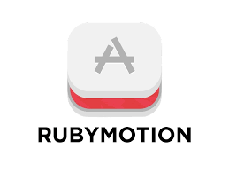







Cross-Platform Mobile Development Tools

Slide 4
Cross-Platform Mobile Development Languages
C++
Qt
Javacript
Cordova / Phonegap
Nativescript
C#
Xamarin
IFactor
Lua
Ruby
Corona
Rubymotion
ReactNative
Kony
Appcellerator

Slide 5
The Big 3
Three of the most popular Cross-Platform Mobile Development tools.

Slide 6
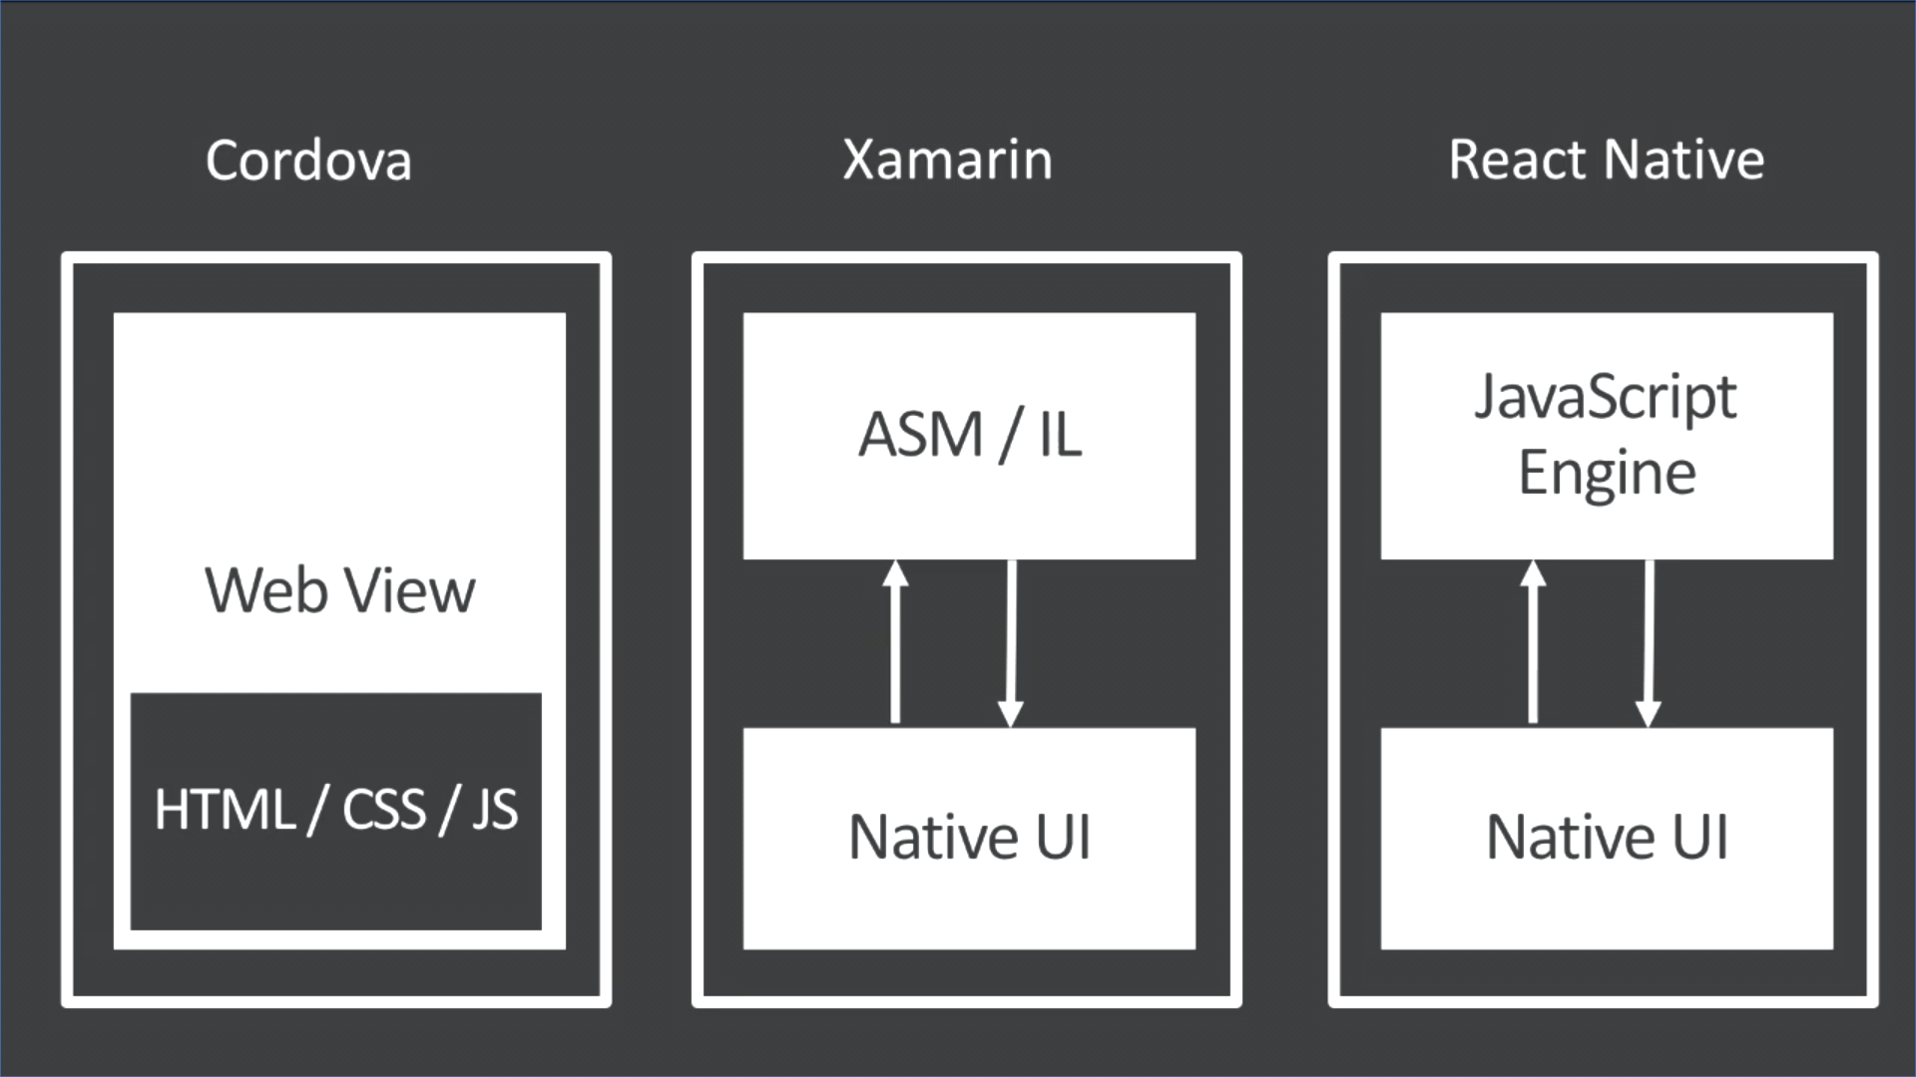
Build Build Build

Slide 7
Demo

Slide 8

Myth Busters
Cross-platform app is not native

Slide 9

Myth Busters
Cross-platform app is slow

Slide 10

Myth Busters
Cross-platform has limited access to native features

Slide 11

Myth Busters
Cross-platform app is bloated

Slide 12

Commonly Ask Questions
Should I develop an App for iOS or Android first?

Slide 13

Commonly Ask Questions
Where is the best place to go if I get stuck into something?

Slide 14

Tips and Tricks
Xamarin.Forms

Slide 15
Demo
Xamarin.Forms

Slide 16

It's a Disastah!
Disastrous Mistakes for Cross-Platform Mobile Development

Slide 17
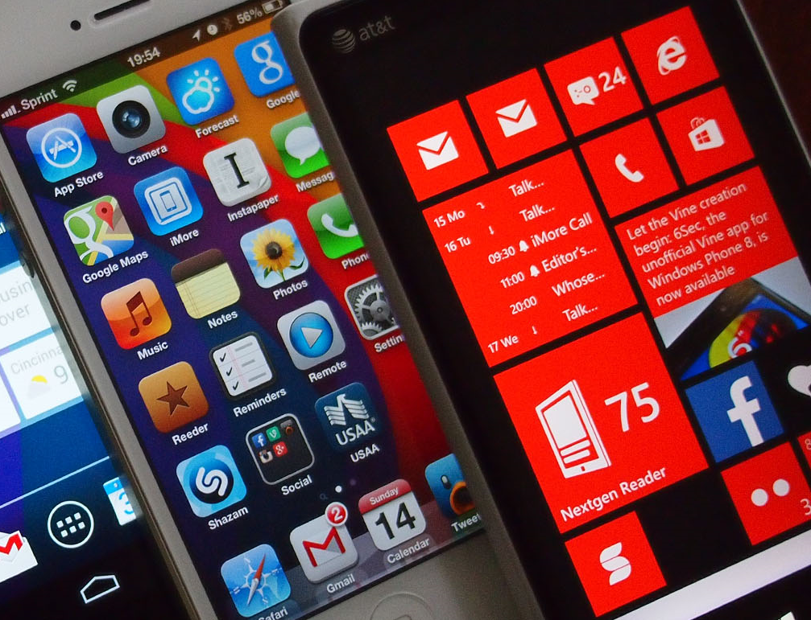
Overemphasize One Platform

Slide 18
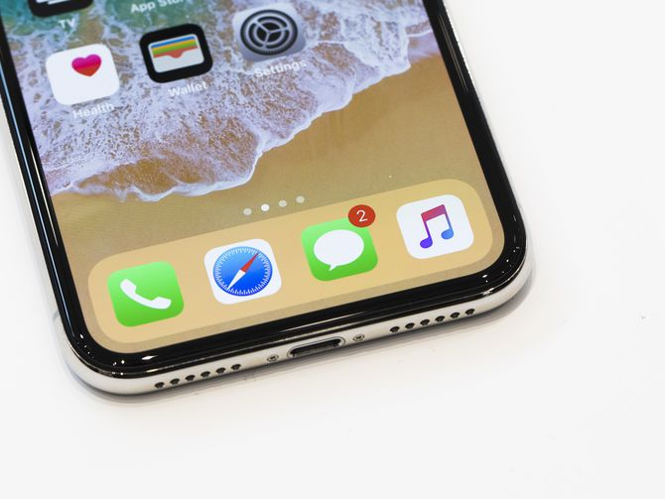
Not explicitly identifying all target devices and OS versions

Slide 19

Ignoring memory management (e.g. unsubscribing from all events)

Slide 20

Ignore Logging

Slide 21



